Slide 1
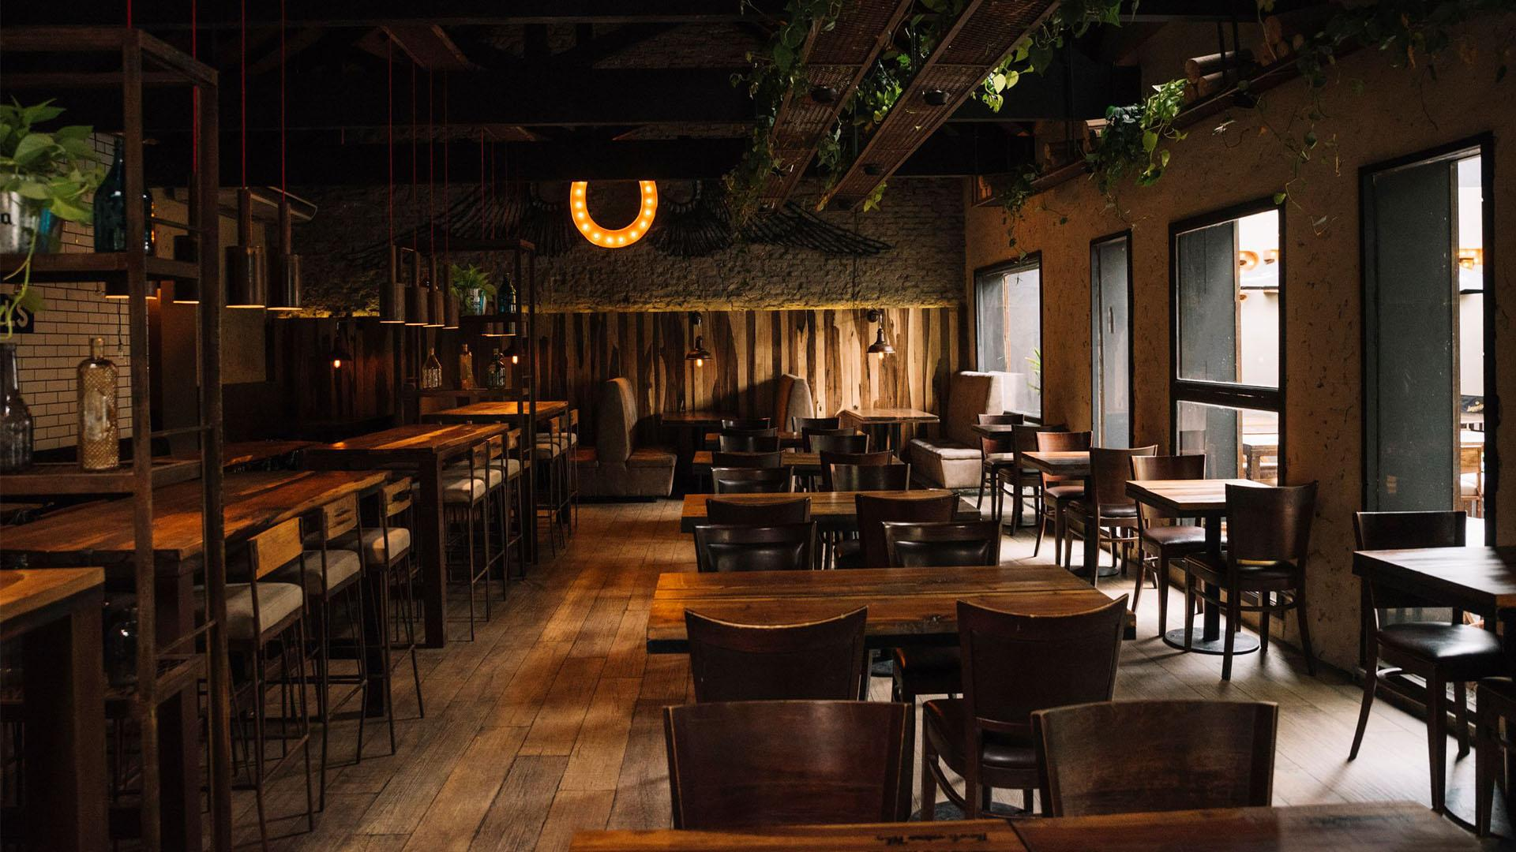
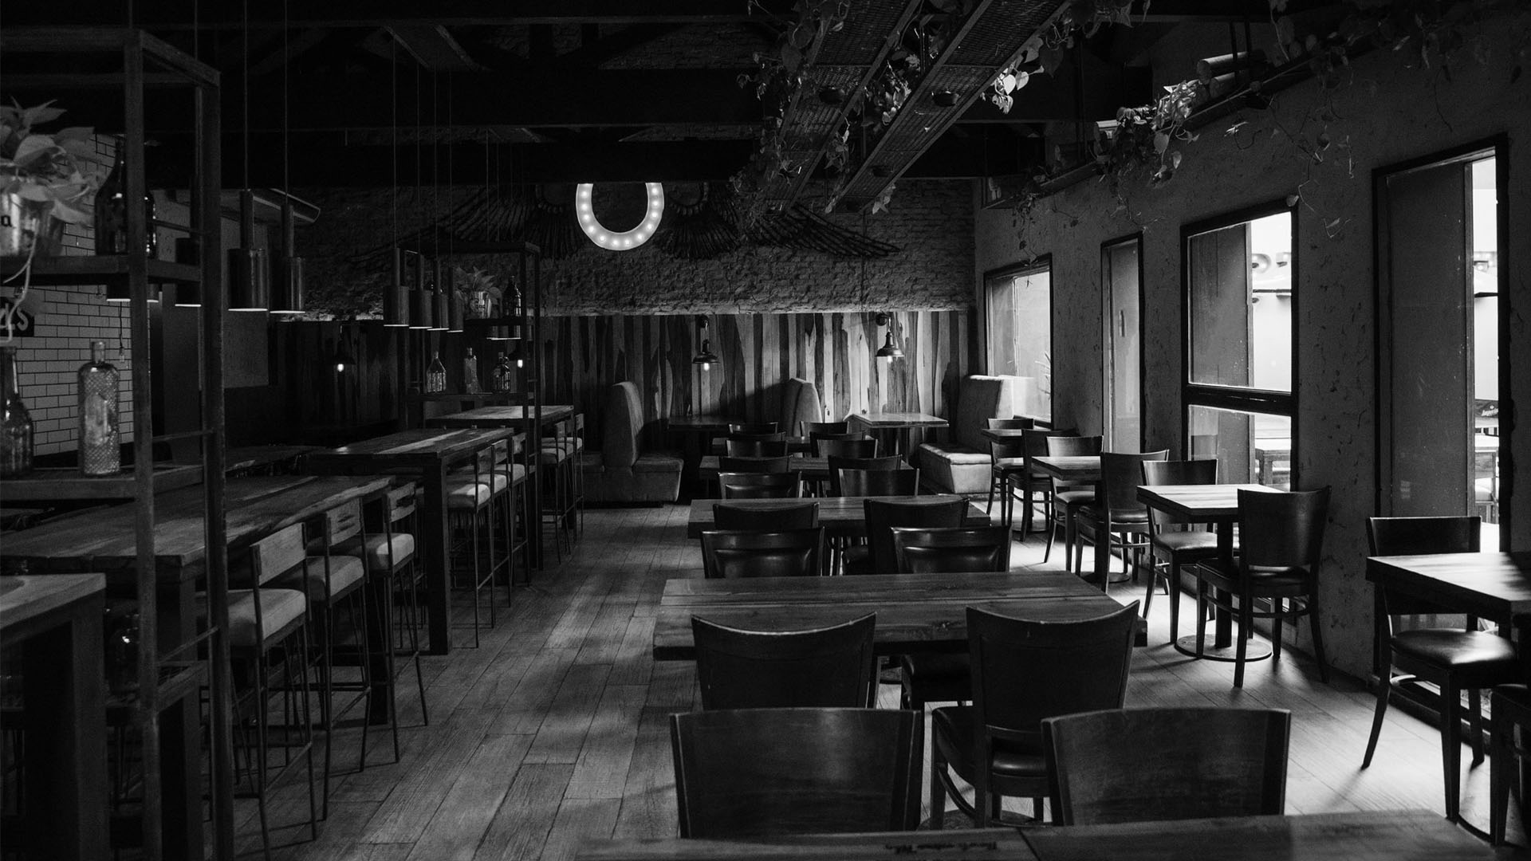
Yelp Restaurant Review
By: Muhammad Faiz Bin Mohd Puad

Slide 2
AGENDA
01
02
04
03
INTRODUCTION
&
PROBLEM STATEMENT
EXPLORATORY DATA ANALYSIS
&
MODEL PREPARATION
CONCLUSION
&
RECOMMENDATION
REFERENCES
Page 1

Slide 3

INTRODUCTION
Emergence of platform like Yelp help business owner i.e. restaurant may continually improve through study of diners' eating experiences and review of the cuisine and service. Reevaluate its business plan, which has a significant economic value.
From customer P.O.V, they may steer clear of uncomfortable situations by eating experience and learn more about regional specialties by reading reviews of the cuisine.
Page 2

Slide 4

PROBLEM STATEMENT
Newly open Restaurant need to face with potential hype of food’s trend of preference by customers due to cultural preference [4]. It can even be influenced by geographical aspect [4]. Thus, it is most likely to lose significant revenue due to inadequate research for start up [1].
Page 3

Slide 5
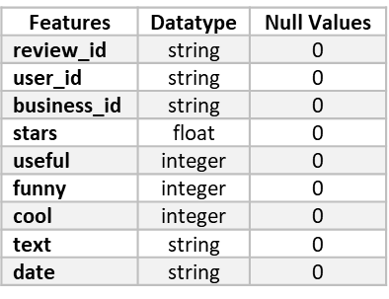
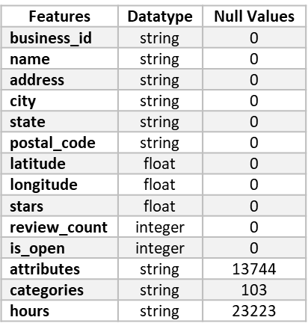
EXPLORATORY DATA ANALYSIS
Business df
150,346 rows & 14 columns
Missing Values:
Attributes : 13,744
Categories : 103
Hours : 23,223
Review df
2 million rows & 9 columns
Table 2.0 : Review df features
Table 1.0 : Business df features
Page 4

Slide 6
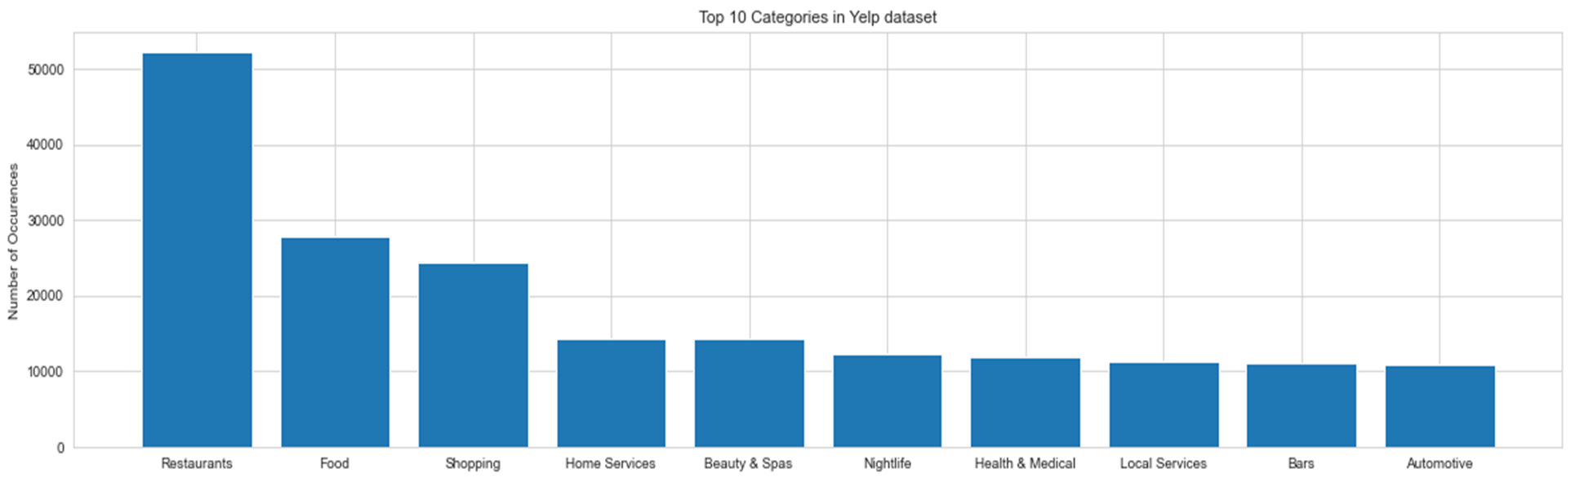
EXPLORATORY DATA ANALYSIS
Figure 1.0 : Top 10 Categories of Industry In Business df
Page 5

Slide 7
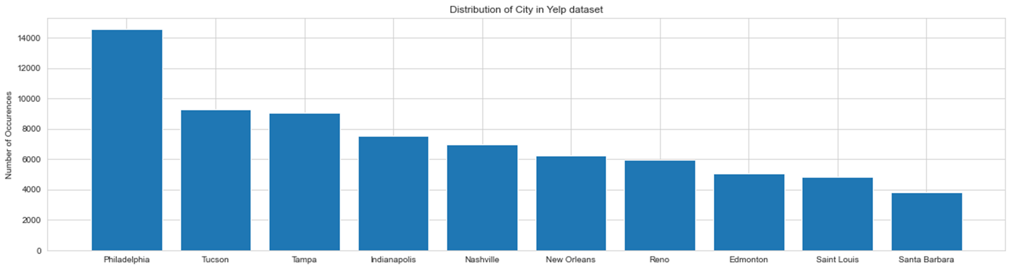
Figure 2.0 : Top 10 Cities With Highest Contain of Industry In Business df
Page 6

Slide 8
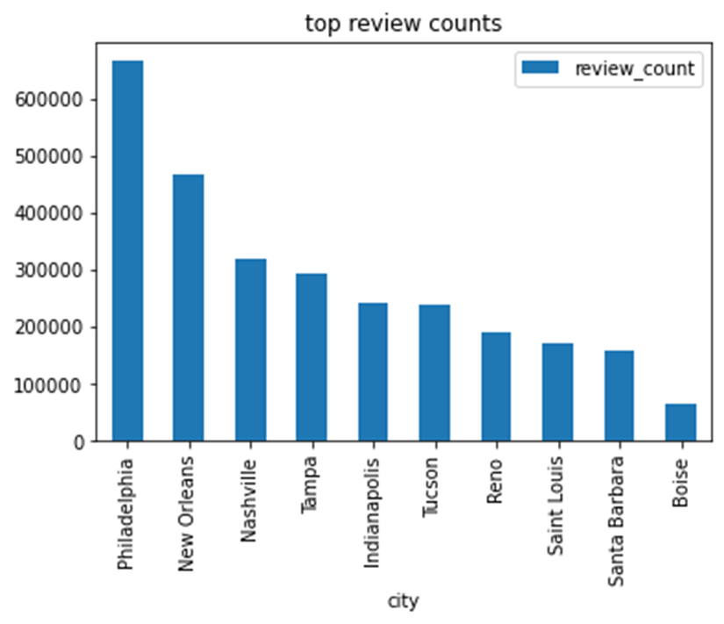
Figure 3.0 : Top 10 Cities With Highest Review Count In Business df
Page 7

Slide 9
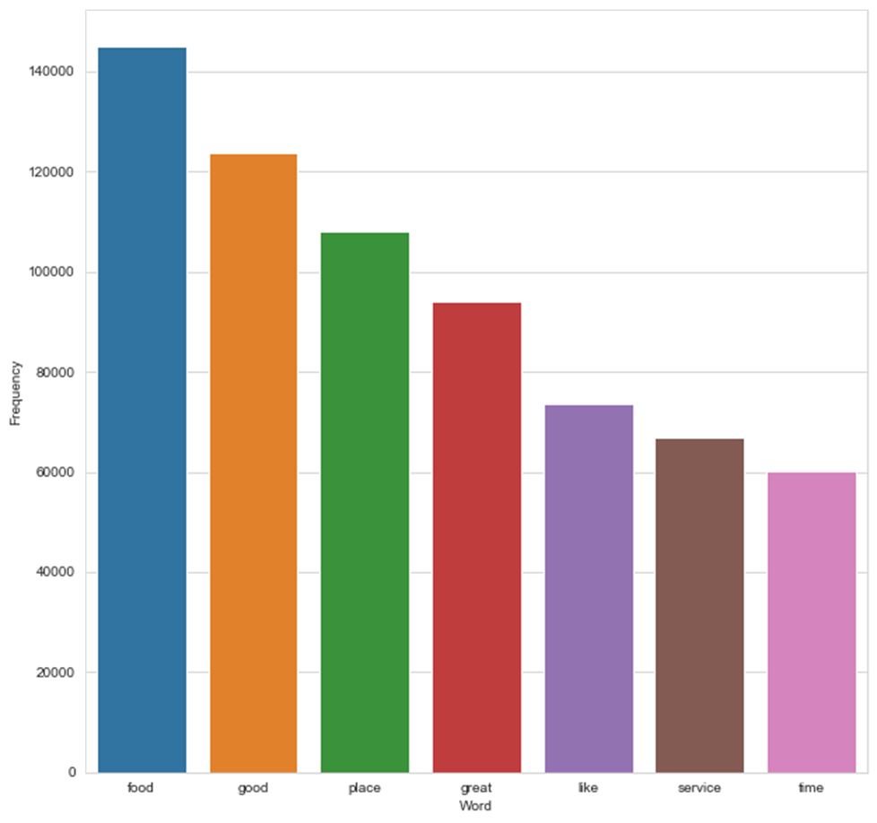
Figure 4.0 : Top Frequent Word Used In Review df
Page 8

Slide 10
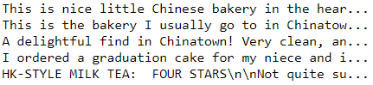
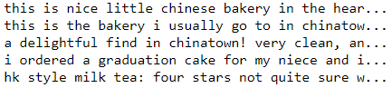
Model Preparation
Missing values replace with ‘unknown’ :
Attributes - 13,744
Categories – 103
Hours – 23,223
Final dataframe:
Business df : 150346 rows, 10 columns
Initial Review df shape : 2,000,000 rows & 9 columns
Final Review df shape : 895930 rows, 6 columns
Preprocess NLP including:
Lemmatizing,
Remove stopwords, symbols, indentation
Page 1
Page 9

Slide 11
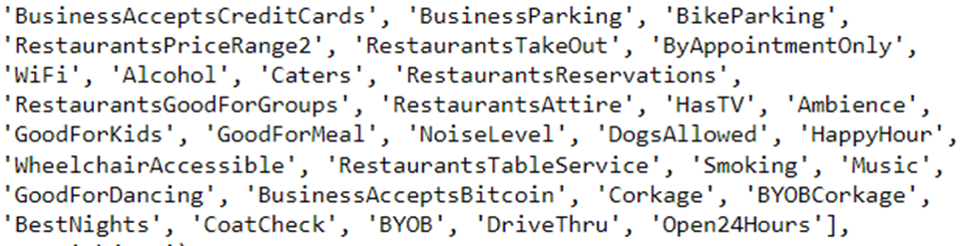
Model Preparation
Table 3.0 : Business df features
Extract subset of attributes
Convert to columns
And dummified
Page 10
Page 1

Slide 12
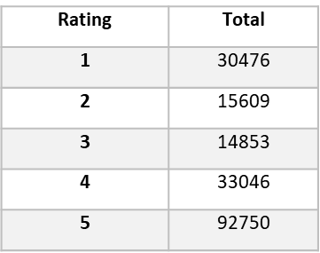
Model Preparation
A. Predict Rating Using Reviewer’ comment
Table 4.0 : Value Count of Each Rating
Check unbalance ranking
Perform SMOTE to balance
Naïve Bayes & Random Forest Model
X = ‘text’ features
Y = ‘reviewer rating’ label
Train Test Split → train: 75% & test: 25%
Transformers: Count Vectorizer & Tfidf Vectorizer
Page 11
Page 1

Slide 13
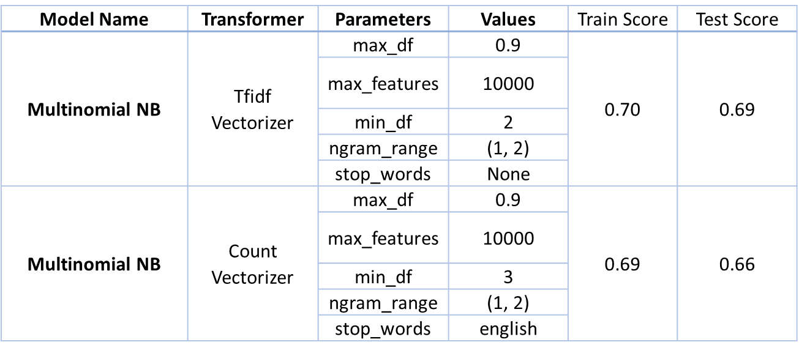
Model Preparation
A. Predict Rating Using Reviewer’ comment
Table 5.0 : Estimators with transformers and their parameter setup
Page 12
Page 1

Slide 14
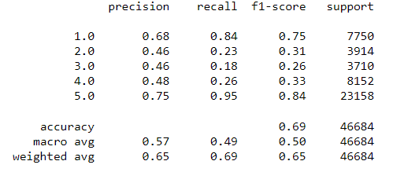
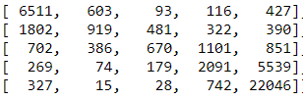
Model Evaluation
A. Predict Rating Using Reviewer’ comment
Table 6.0 :Naïve Bayes Model with Tfidf Transformer score
Table 7.0 :Confusion Matrix of Naïve Bayes Model
Page 13
Page 1

Slide 15
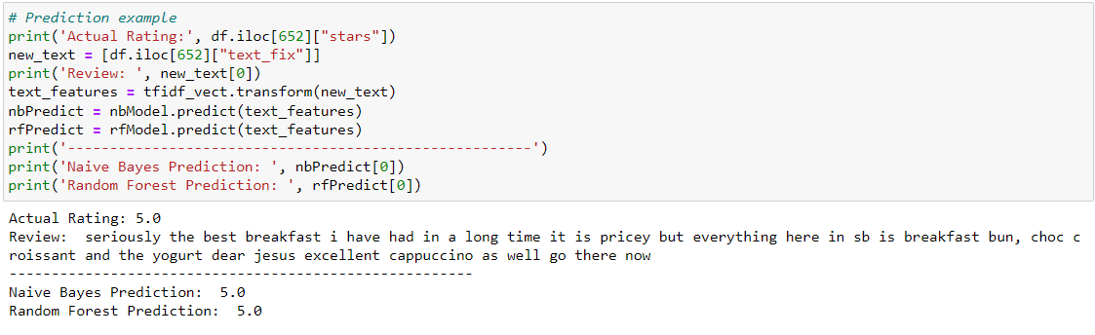
Model Testing
A. Predict Rating Using Reviewer’ comment
Figure 5.0 : Snapshot of Model Testing on Test Dataset
Page 14
Page 1

Slide 16
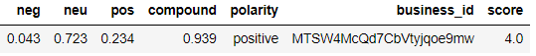
Model Preparation
B. Predict Rating Using Business Attributes
Create new features that contain text polarity and Label each reviewer’s rating into:
Less than 3 is negative
More than 3 is positive
Equals 3 is neutral
Table 8.0 :Sentiment Polarity Score Applied On Review df
2. Transform categorical columns to numerical using label encoder
Table 9.0 :Transformed Review df’s attributes columns
Page 15
Page 1

Slide 17
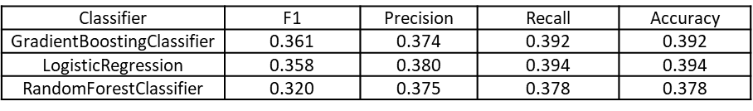
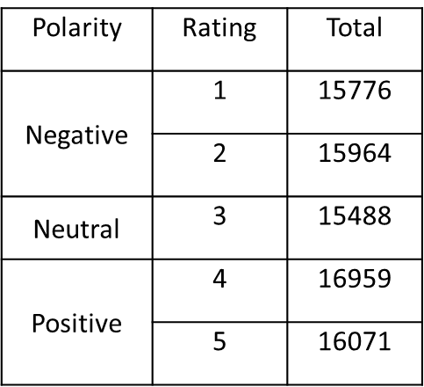
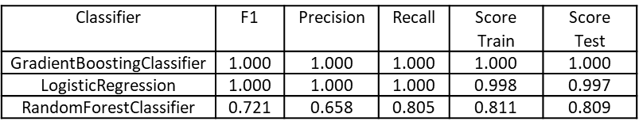
Model Evaluation
B. Predict Rating Using Business Attributes
Table 10.0 : Score of Models on Not Normalized Rank Data
Table 12.0 :Count of Rating Based on Polarity
Table 11.0 : Score of Models on Normalized Rank Data
Page 16
Page 1

Slide 18
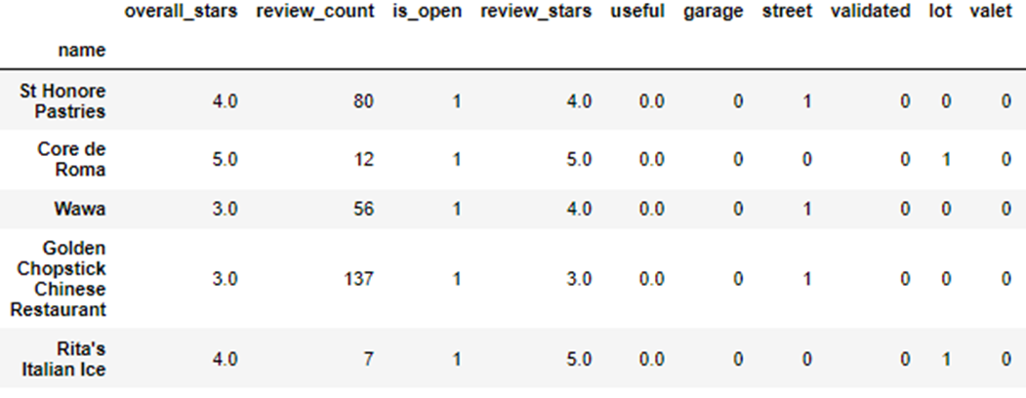
Model Preparation
C. Recommender System
Combine attribute from Business dataset with review id
Attributes about 116 columns used
Drop duplicate business name
Change name as business index
Table 13.0 : Dataframe With Index As Label And Attributes As Columns
Page 17
Page 1

Slide 19
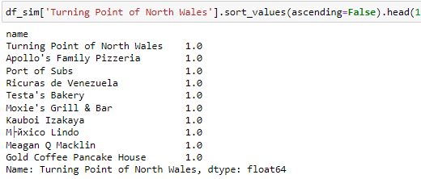
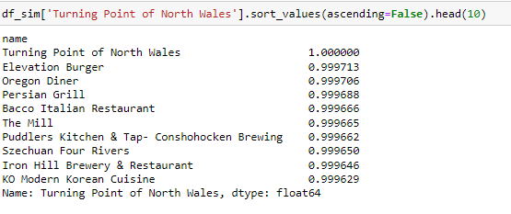
Model Testing
C. Recommender System
Figure 5.0 : Recommend of Similar Restaurant Without Attributes Influence
Figure 6.0 : Recommend of Similar Restaurant With Attributes Influence
Page 18
Page 1

Slide 20
CONCLUSION & RECOMMENDATION
1. In multiclass classification prediction, gradient bossting classifier perform the best with F1 score of 1 .
2. For prediction using text input, Multinomial Naive Bayes perform at moderately average at 0.69.
3. Increasing bag of word could help increasing Multinomial performance but computational heavy. Bias in review itself is also factor that reduce the score [3].
4. For future work, is a possibility to combine multiclass approach which use attributes and combine with bag of words to further increase model performance to predict rating.
5. This is shown in recommender system too as more variance introduce(attributes introduce), more relevant restaurant are recommended.
Page 19

Slide 21
REFERENCES
Failory.com. What Was Sprig? Available online: https://www.failory.com/cemetery/sprig (accessed on 10 May 2022).
Adak, Anirban & Pradhan, Biswajeet & Shukla, Nagesh. (2022). Sentiment Analysis of Customer Reviews of Food Delivery Services Using Deep Learning and Explainable Artificial Intelligence: Systematic Review. Foods. 11. 1500. doi:10.3390/foods11101500.
Y. Jiang, "Restaurant Reviews Analysis Model Based on Machine Learning Algorithms," 2020 Management Science Informatization and Economic Innovation Development Conference (MSIEID), 2020, pp. 169-178. doi: 10.1109/MSIEID52046.2020.00038.
H.L. Meiselman, R. Bell, in Encyclopedia of Food Sciences and Nutrition (Second Edition), 2003
Page 20

Slide 22
THANK YOU
Page 1

